Slide 1


Warren Buffet vs Monkeys & Investment Funds
Bugeda, Cristobal
Pérez, Laura
Ramos, Sergio
Notes:
© Copyright PresentationGO.com – The free PowerPoint and Google Slides template library

Slide 2
Motivation & Summary
Notes:
© Copyright PresentationGO.com – The free PowerPoint and Google Slides template library

Slide 3
Motivation
Warren Buffett, aka the “Oracle of Omaha”, theorizes that “A blindfolded monkey throwing darts at a newspaper’s financial pages could select a portfolio that would do just as well as one carefully selected by experts.” The ‘experts’, understandably, were not amused.”
Can one of the most successful and wealthy investors of all time, with a current net worth of $73.4B USD¹, be correct? Is it possible that any random monkey can choose an investment portfolio that will, at least, have positive performance over one chosen carefully by a professional broker?
Notes:
© Copyright PresentationGO.com – The free PowerPoint and Google Slides template library

Slide 4
Summary
Key Takeaway:
It is better to put your money into a portfolio of 10 random stocks with random weights, than keeping it in your bank account. Here is why:
Money sitting in a bank account loses value through depreciation.
The generalized fear of investing can keep you from (in three out of four times) generating a shield against depreciation.
Notes:
© Copyright PresentationGO.com – The free PowerPoint and Google Slides template library

Slide 5
Questions and Data
Notes:
© Copyright PresentationGO.com – The free PowerPoint and Google Slides template library

Slide 6
Questions
We know that up to now, you must have a ton of questions. We had them, too. Here are the most significant:
Can a monkey really do such a complex task?
What is the safest bet for allocating my savings?
How does this experiment affect the market?
Notes:
© Copyright PresentationGO.com – The free PowerPoint and Google Slides template library

Slide 7
Data
First of all, we need data to do a data analysis.
Luckily, exchanges work with data every day, almost real time. We just needed to scope our search to find out what information and where to obtain it.
We made use of amazing tools like Yahoo Finance (and the work of a good samaritan that documented it)² as well as Exchange information from S&P500 Index (SPY).
Notes:
© Copyright PresentationGO.com – The free PowerPoint and Google Slides template library

Slide 8
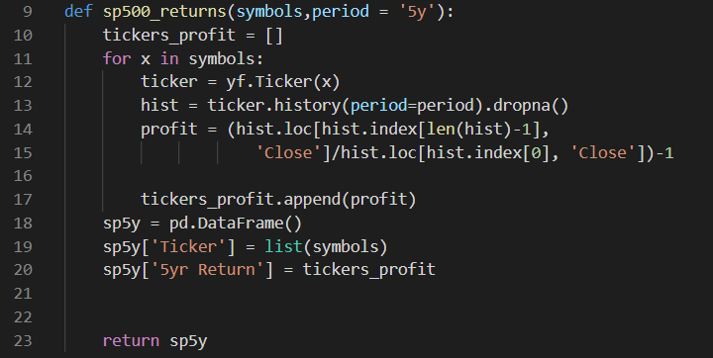
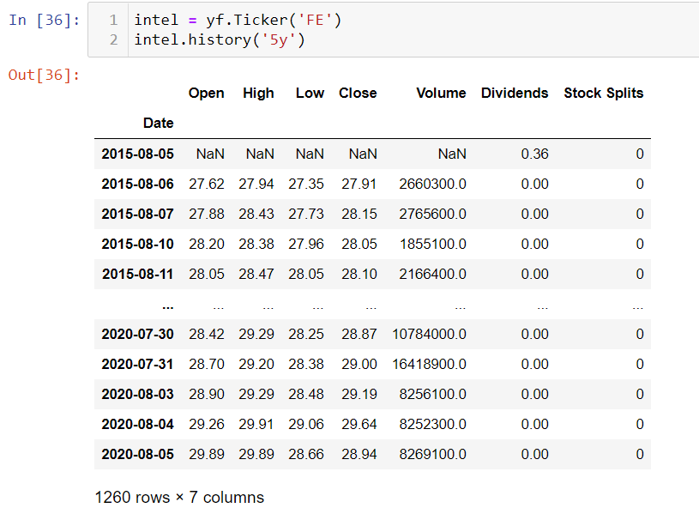
Data Cleanup
We had to eliminate NaNs through the root return function.
Notes:
© Copyright PresentationGO.com – The free PowerPoint and Google Slides template library

Slide 9
Data Analysis
Notes:
© Copyright PresentationGO.com – The free PowerPoint and Google Slides template library

Slide 10
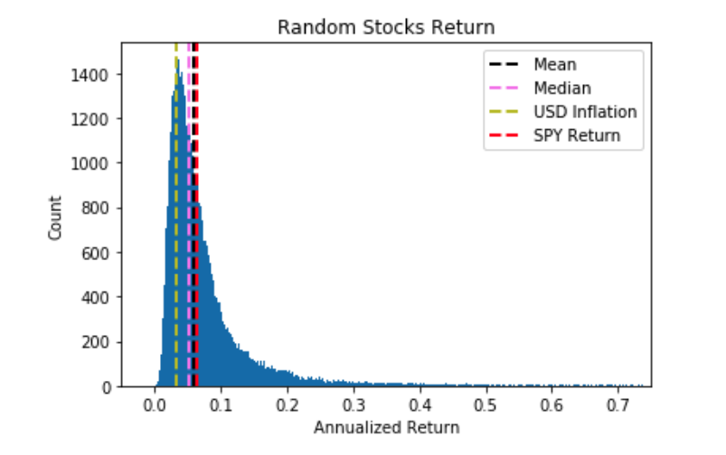
Data Analysis, a summary
Can a monkey really do it?
We had 100,000 monkeys creating random portfolios with randoms stocks and random weights. The returns for a 20 year period were as follows.
Notes:
© Copyright PresentationGO.com – The free PowerPoint and Google Slides template library

Slide 11
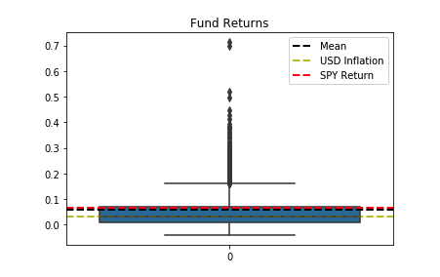
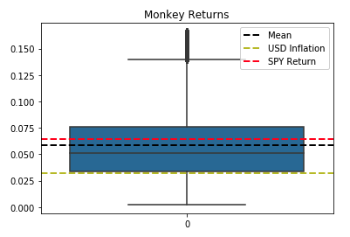
What is the safest bet for allocating my savings?
How does this experiment affect the market?
Notes:
Monkeys were normalized, outlieres were eliminated through IQR

Slide 12
Conclusions
Notes:
© Copyright PresentationGO.com – The free PowerPoint and Google Slides template library

Slide 13
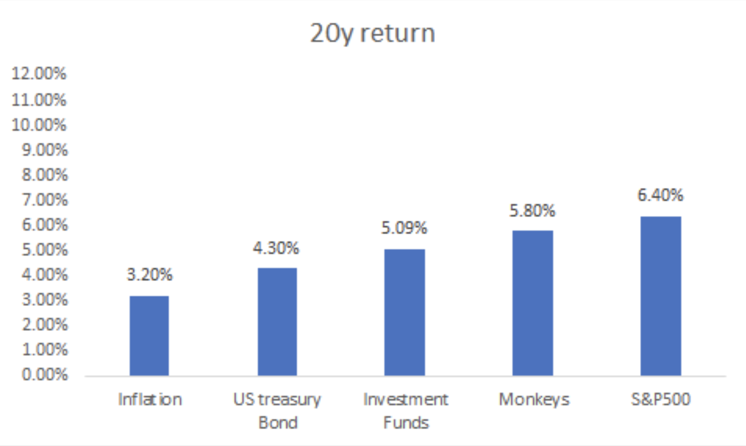
Conclusion
Notes:
© Copyright PresentationGO.com – The free PowerPoint and Google Slides template library

Slide 14
Thank You!
Open Q&A
Notes:
© Copyright PresentationGO.com – The free PowerPoint and Google Slides template library

Slide 15
Bibliography
https://www.forbes.com/profile/warren-buffett/#2289175d4639
https://github.com/ranaroussi/yfinance
Notes:
© Copyright PresentationGO.com – The free PowerPoint and Google Slides template library

